Slide 1
Employee Salary Predication
CAPSTONE PROJECT
using Supervised Machine Learning
Presented By:
Mauli Kangude – DYPIU, Pune – B.Tech CSE 2026
AICTE ID : STU676da894dedd51735239828
Mail ID : maulikangude007@gmail.com

Slide 2
OUTLINE
Problem Statement
System Development Approach
Algorithm & Deployment
Result
Conclusion
References

Slide 3
Problem Statement
Predicting an employee’s salary based on factors like education, experience, and location is essential for HR planning and budgeting.
Objective: Build a machine learning model to estimate salaries using historical data.

Slide 4
System Approach
Platform: Google Colab / Jupyter Notebook
Programming Language: Python
Libraries: pandas, numpy, matplotlib, seaborn, scikit-learn
ML Model Used: 🔝 Linear Regression and XGBoost (a type of Supervised Learning)
Dataset: Employee salary dataset from Kaggle https://www.kaggle.com/datasets/rkiattisak/salaly-prediction-for-beginer/data

Slide 5
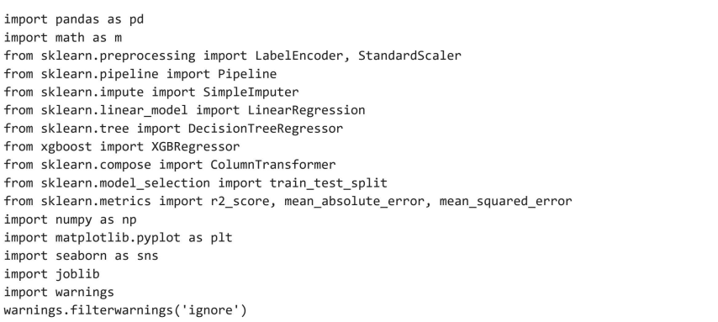
Algorithm & Deployment
Import Libraries

Slide 6
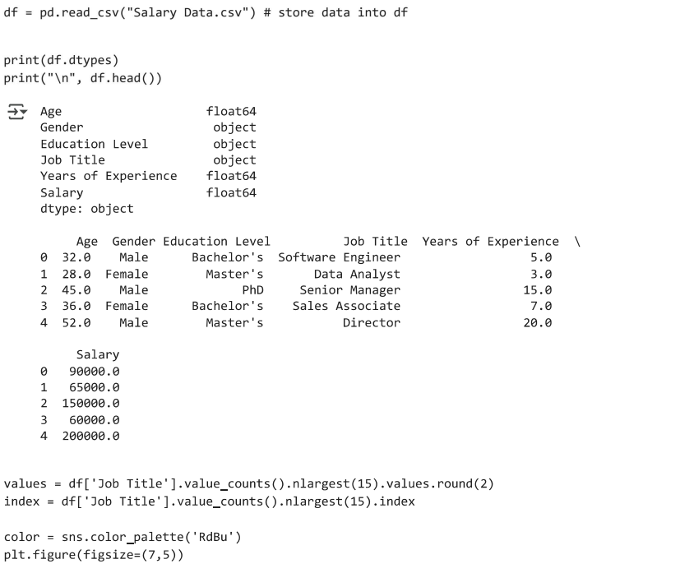
EDA

Slide 7
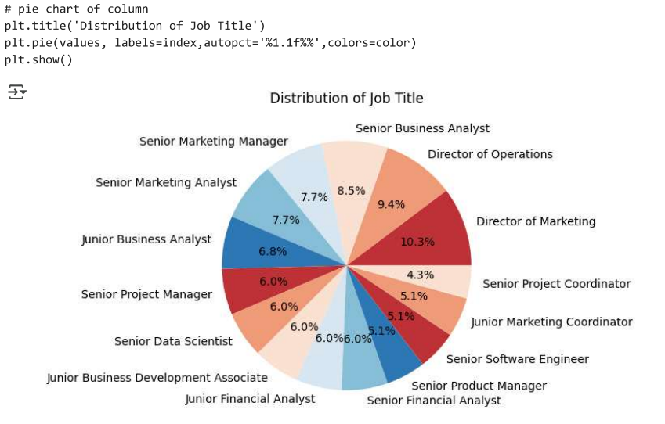
EDA

Slide 8
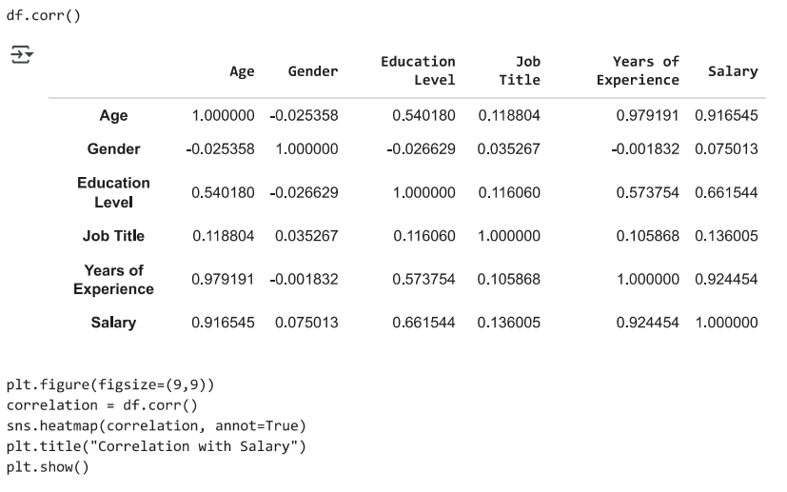
EDA

Slide 9
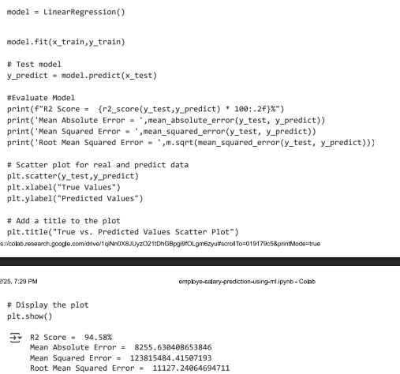
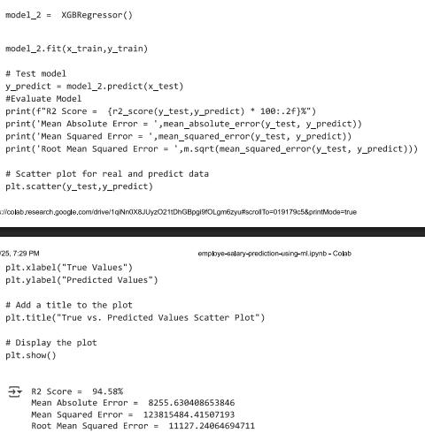
ML Model

Slide 10
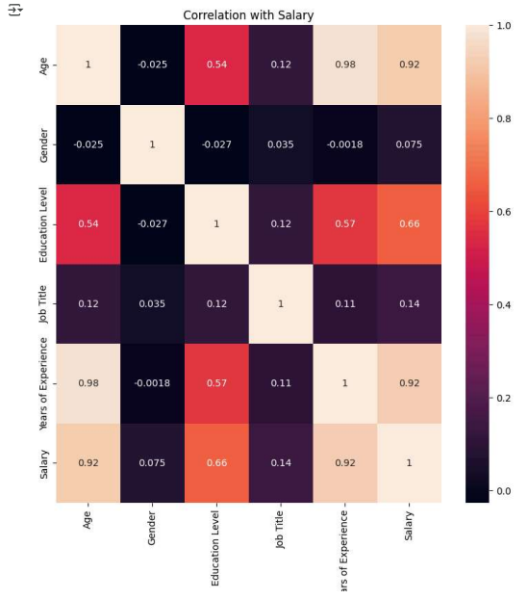
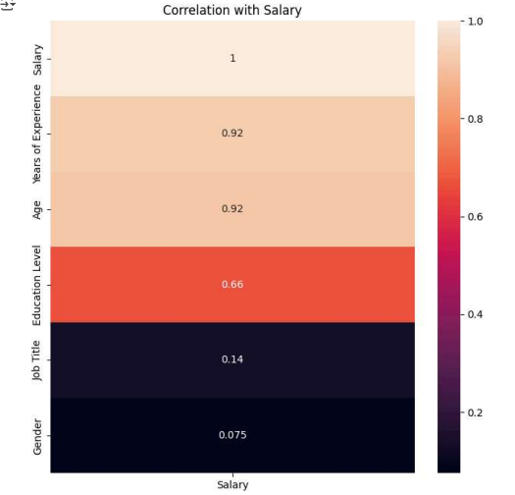
Result : Correlation Matrix

Slide 11
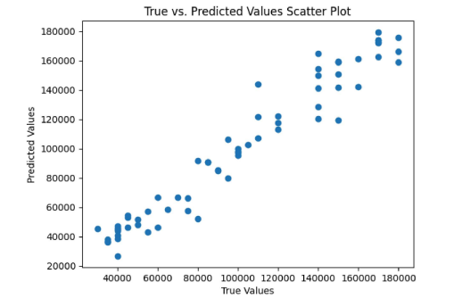
Result : Scatter Plot for ML model

Slide 12
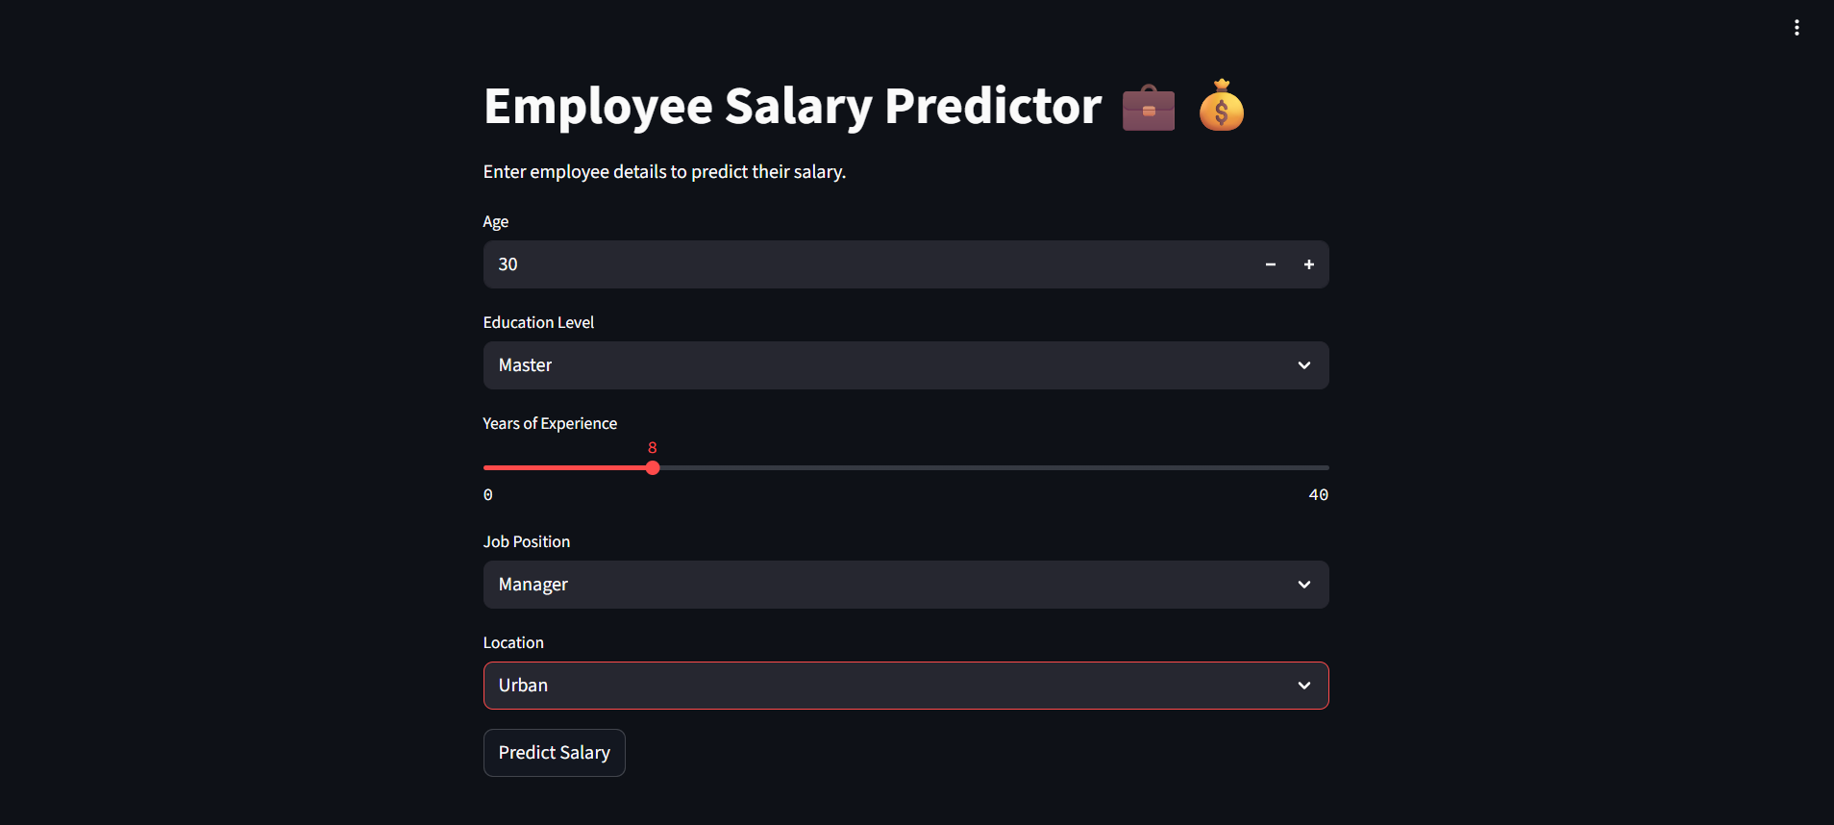
Result : Web page of app using stremlit

Slide 13
Conclusion
Linear Regression effectively models salary prediction
Minimal preprocessing and good performance on small datasets
Demonstrates practical application of supervised ML

Slide 14
References
Dataset Source: Kaggle
Libraries: scikit-learn documentation
Zoom meeting – Edunet foundation
Research papers
https://jicet.org/index.php/JICET/article/view/147
https://www.ijasret.com/VolumeArticles/FullTextPDF/842_47._SALARY_PREDICTION_USING_MACHINE_LEARNING.pdf
https://link.springer.com/chapter/10.1007/978-981-97-9619-9_17
GITHUB LINK : https://github.com/Mauli-09

Slide 15
THANK YOU

